Slide 1
COVID-19 Severity Score Prediction from Chest X-Rays
Awaiz Hussain - 23100185

Slide 2
Research Question
Can deep learning models be used to automate severity scoring of COVID-19 from chest X-rays

Slide 3
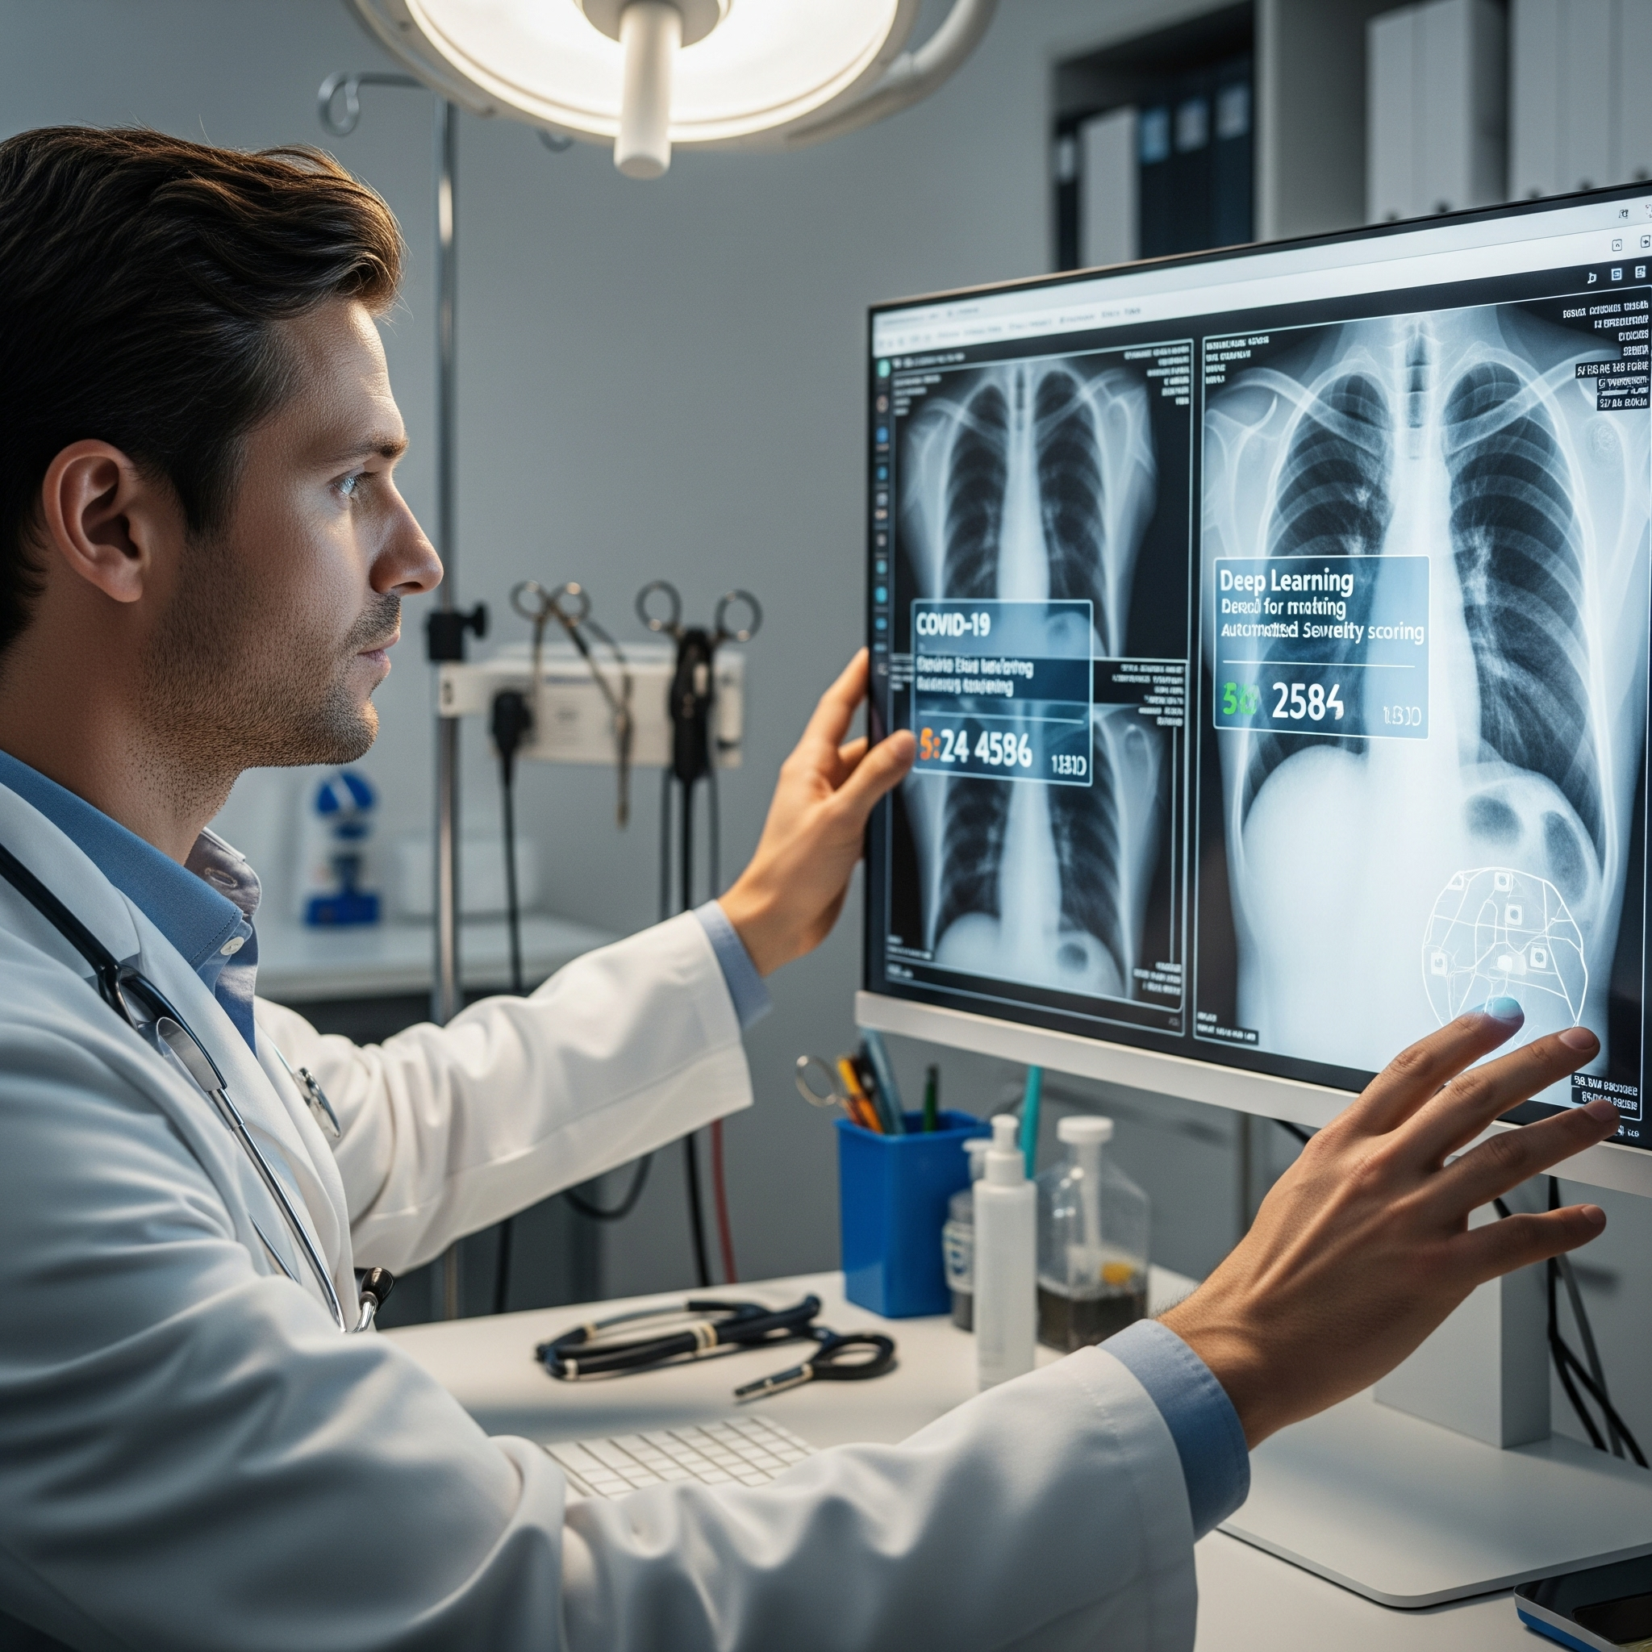
Research Question
Most existing studies on COVID-19 detection from chest X-rays primarily focus on binary classification (COVID-19 vs. Normal/Non-COVID). While useful, this approach lacks the nuanced information required for effective clinical management. Severity scoring provides more actionable insights for:
Triage: Prioritizing patients based on their condition.
Treatment Planning: Guiding therapeutic interventions.
Resource Allocation: Optimizing hospital resources during surges.

Slide 4
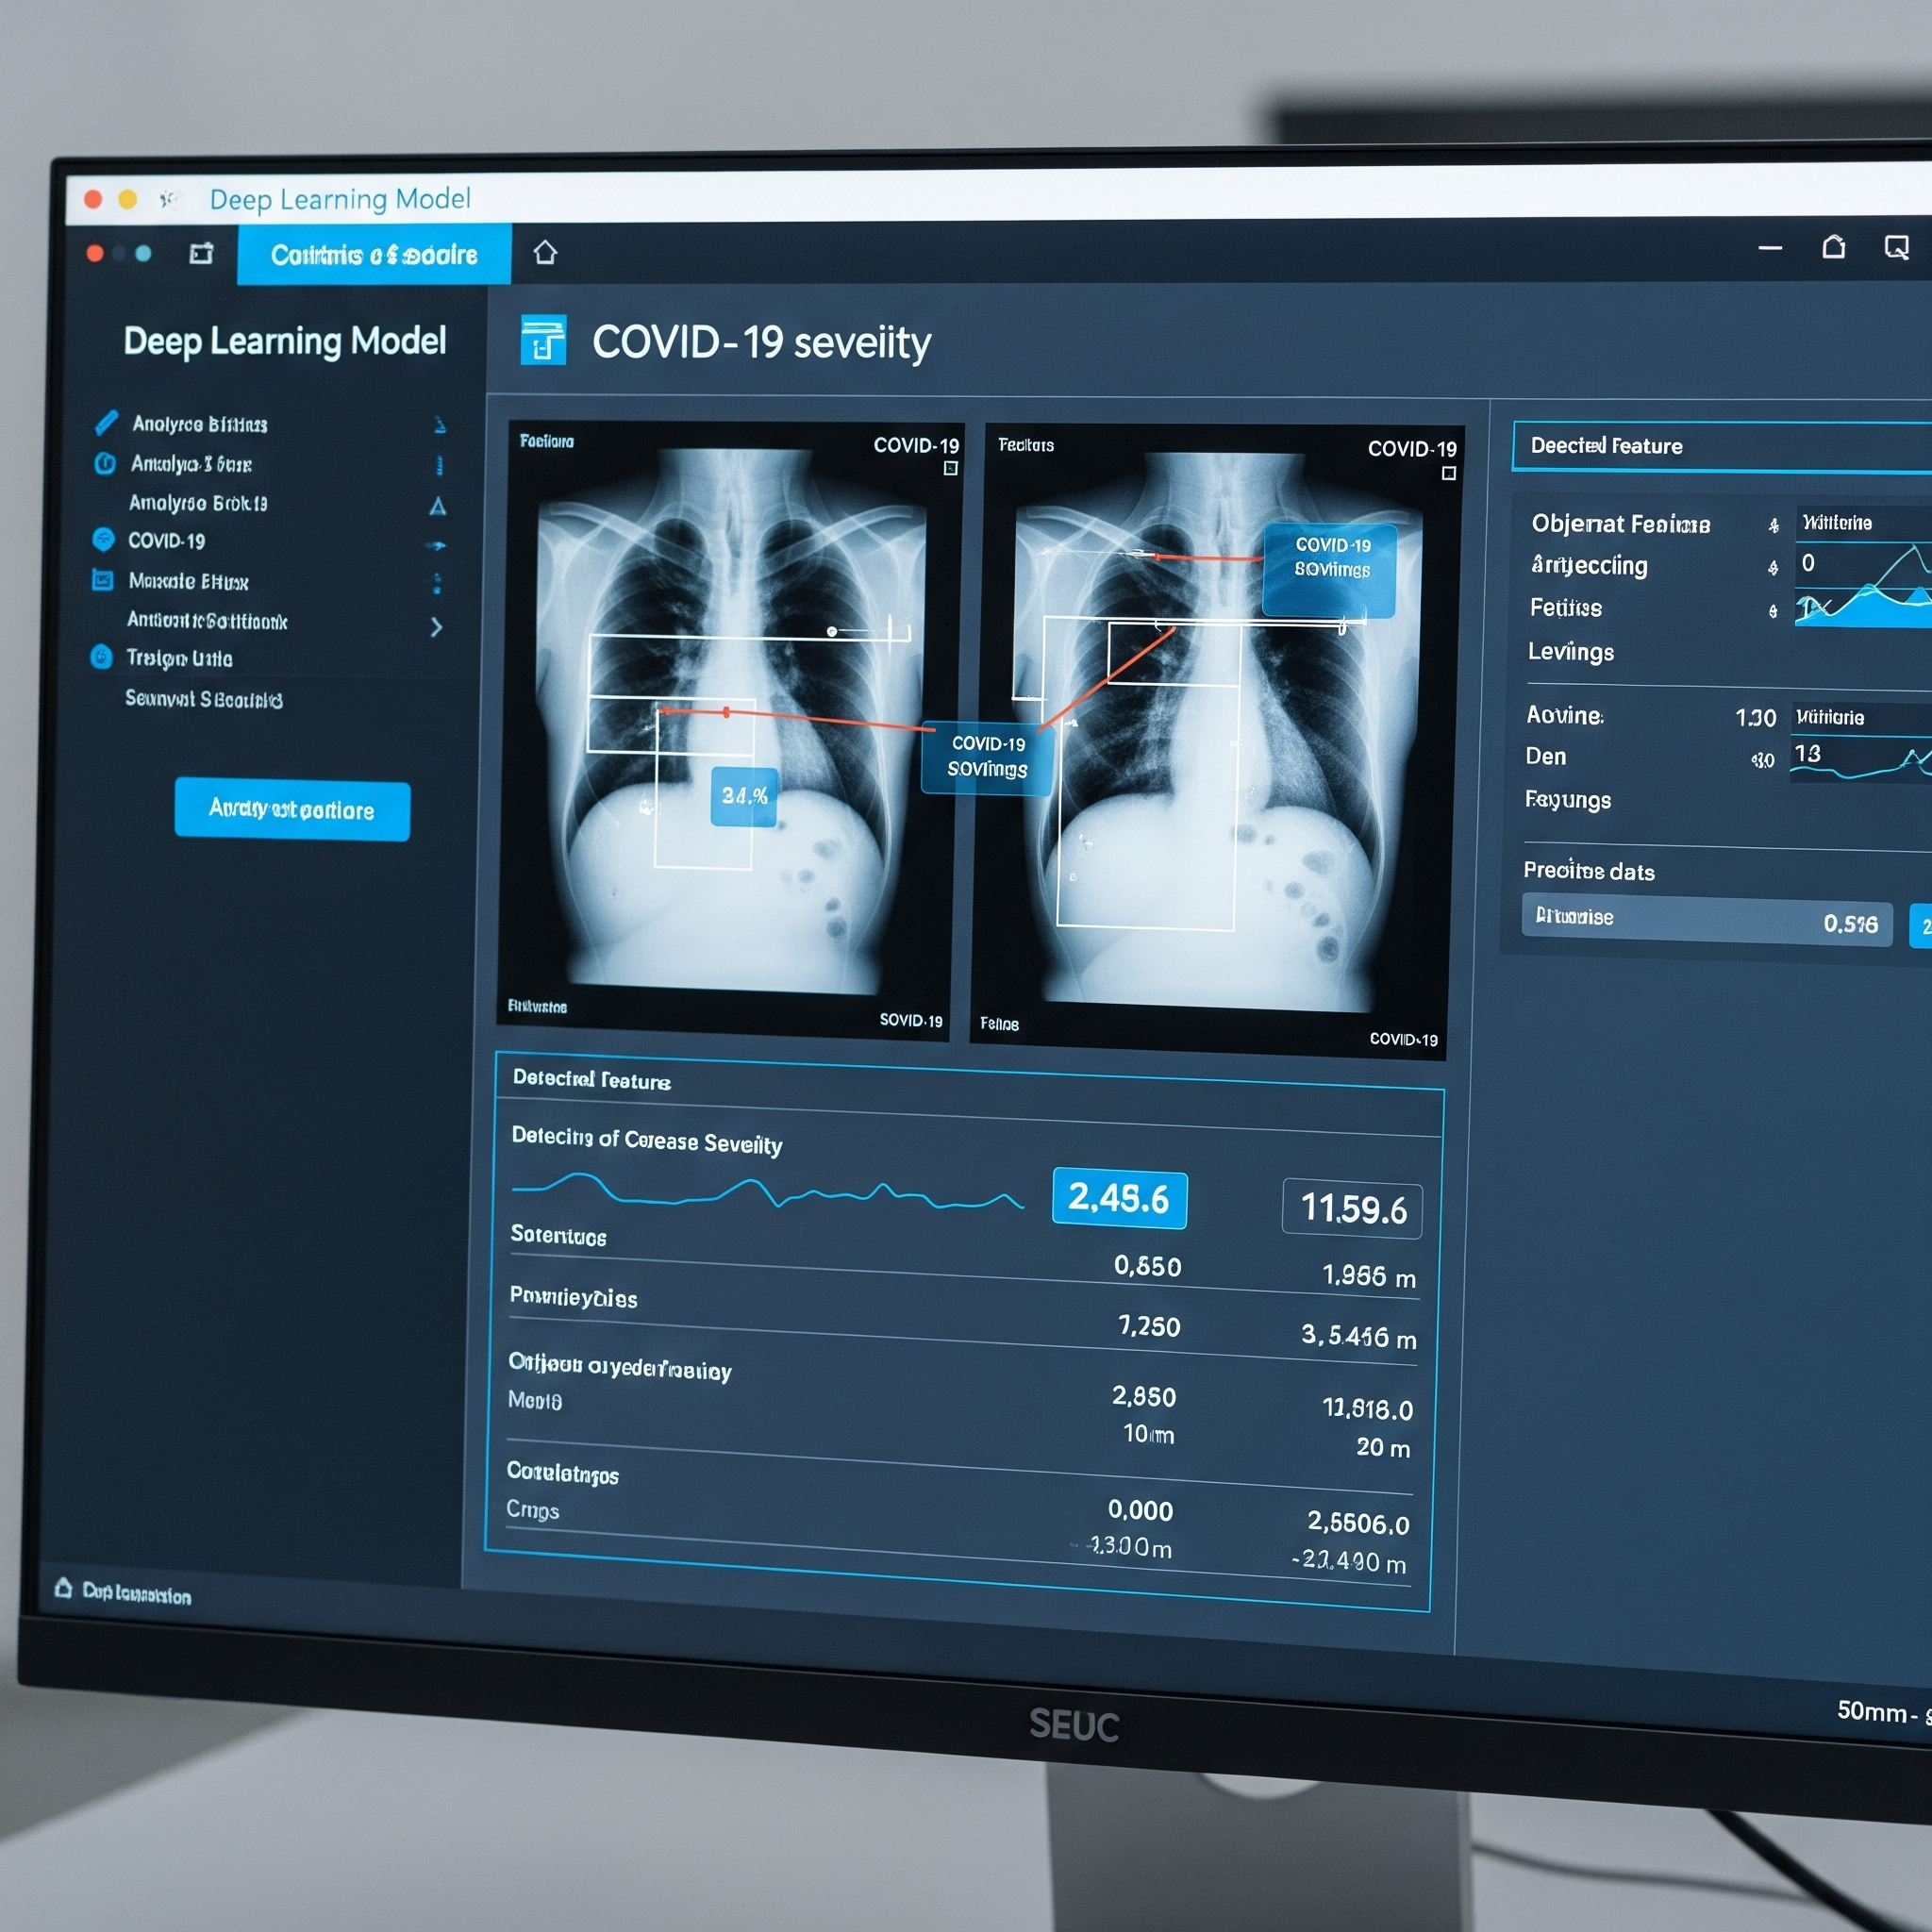
Project Goals and Objectives
Automate COVID-19 severity scoring
Use deep learning models
Analyze chest X-rays for progression
Provide quantitative disease insights

Slide 5
Dataset https://www.kaggle.com/datasets/anasmohammedtahir/covidqu/data

Slide 6
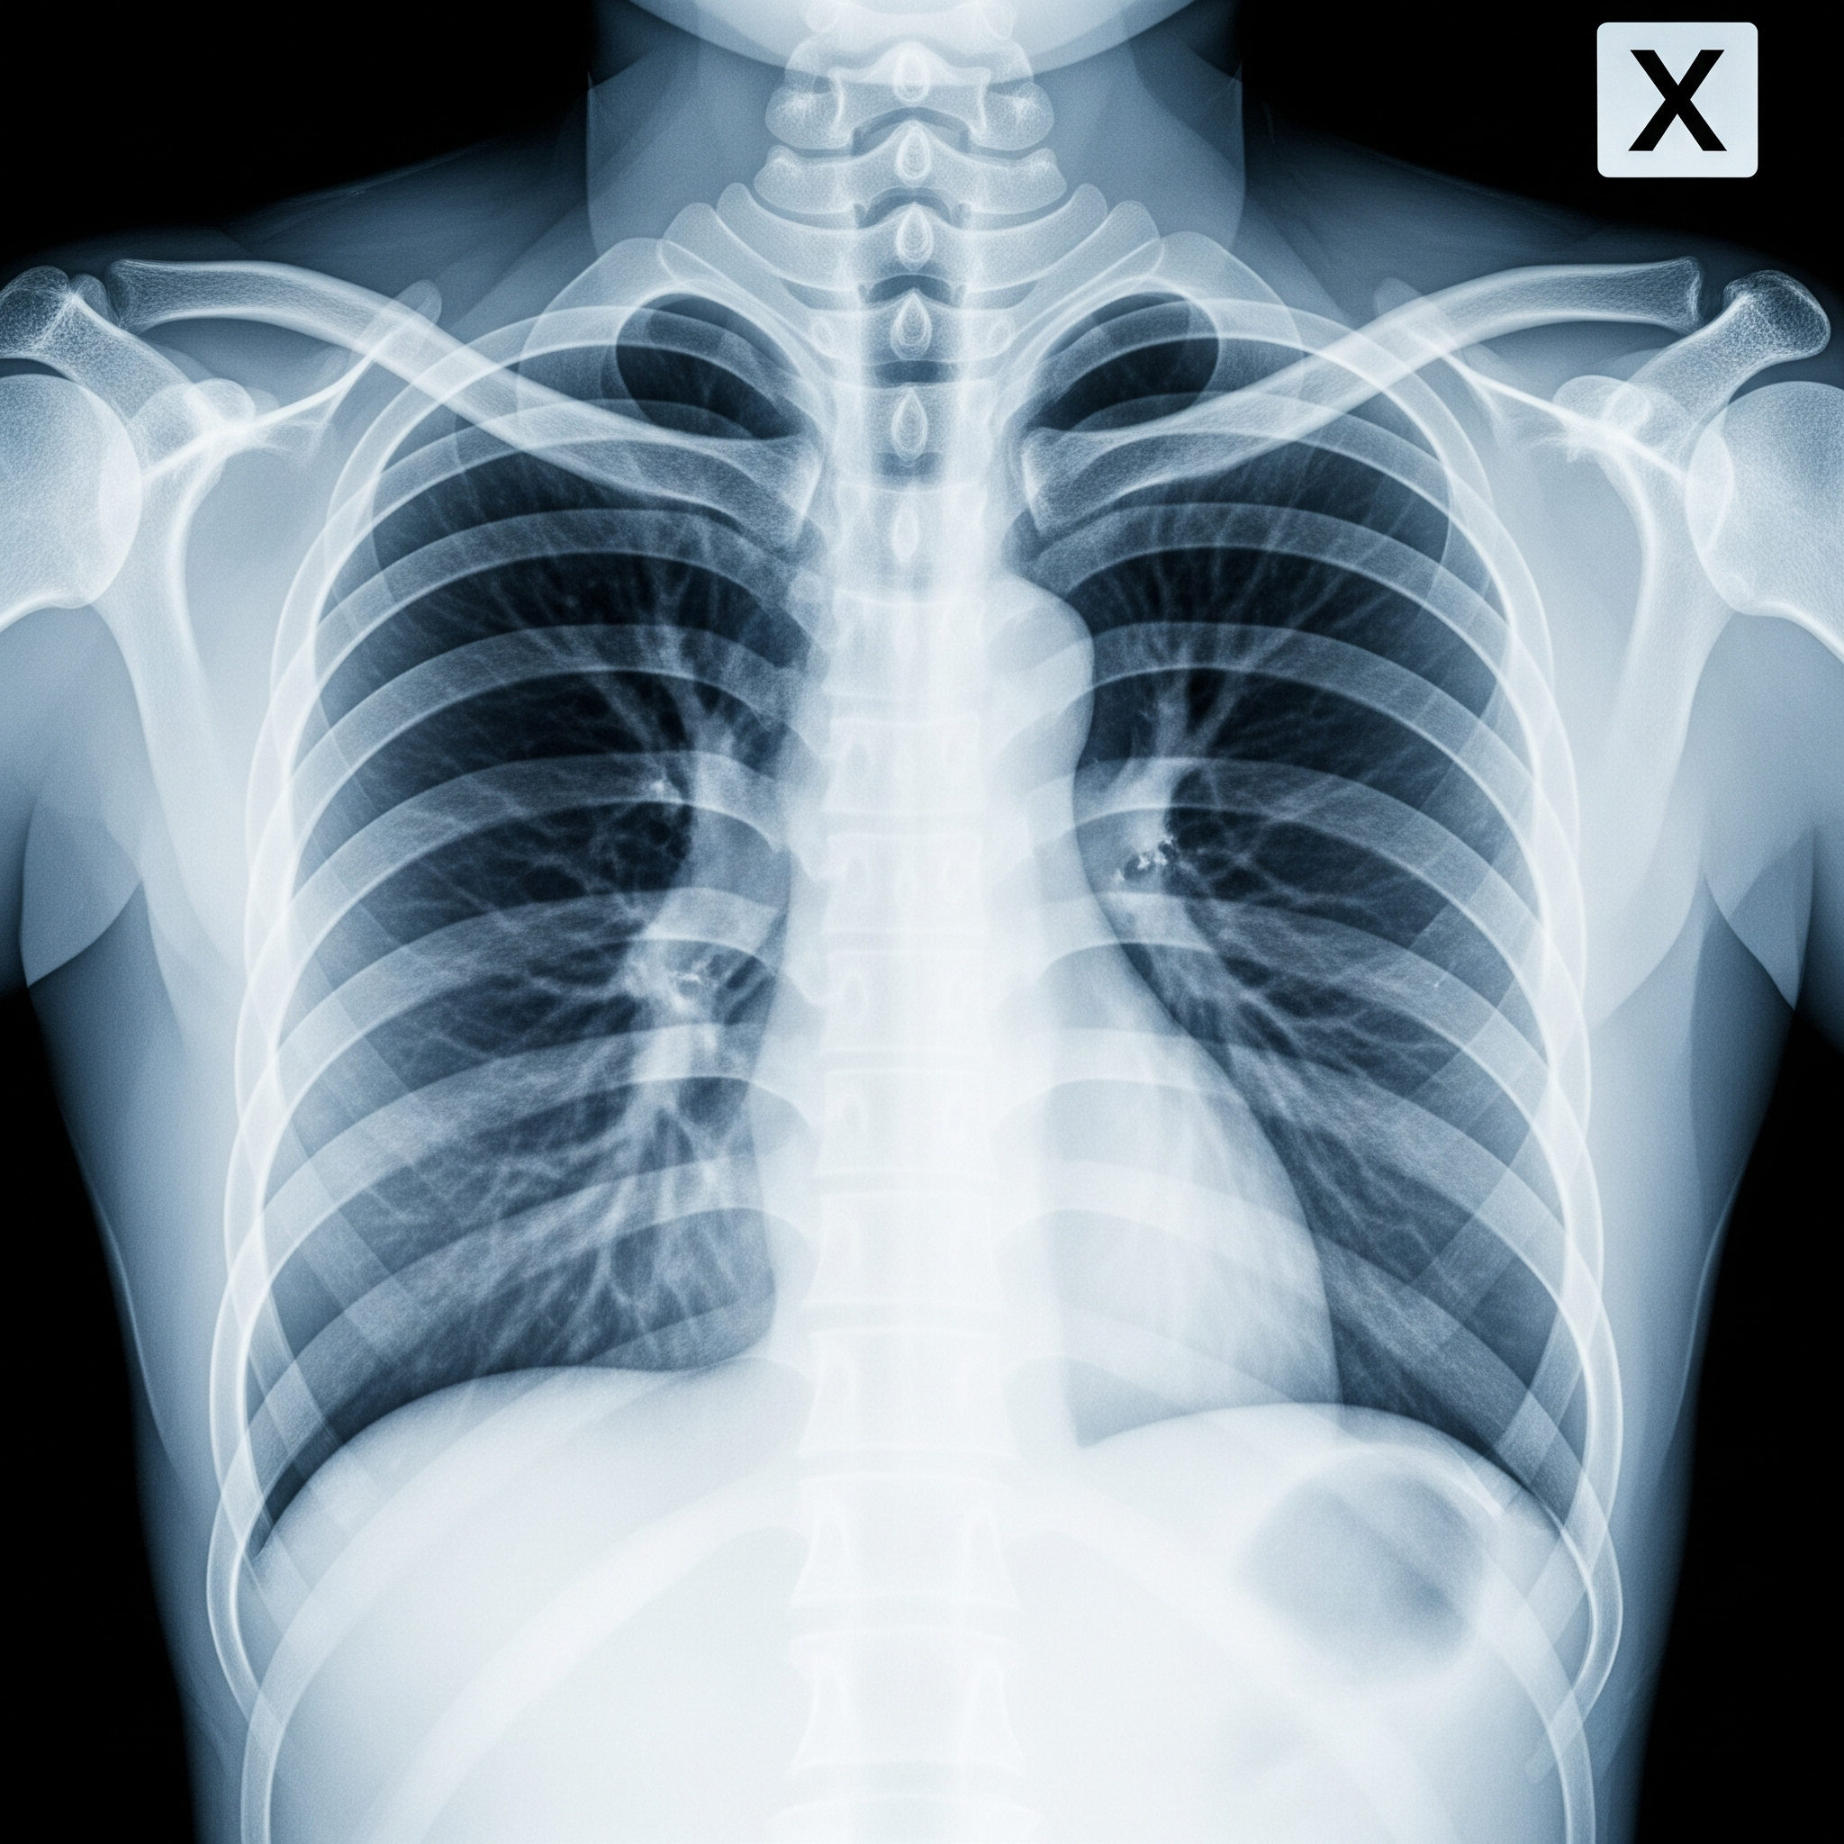
Dataset Overview: COVID-QU
Utilizes COVID-QU dataset from Kaggle
Organized into Lung and Infection Segmentation Data
Data includes original images, lung masks, infection masks
Complete samples with all masks were retained

Slide 7
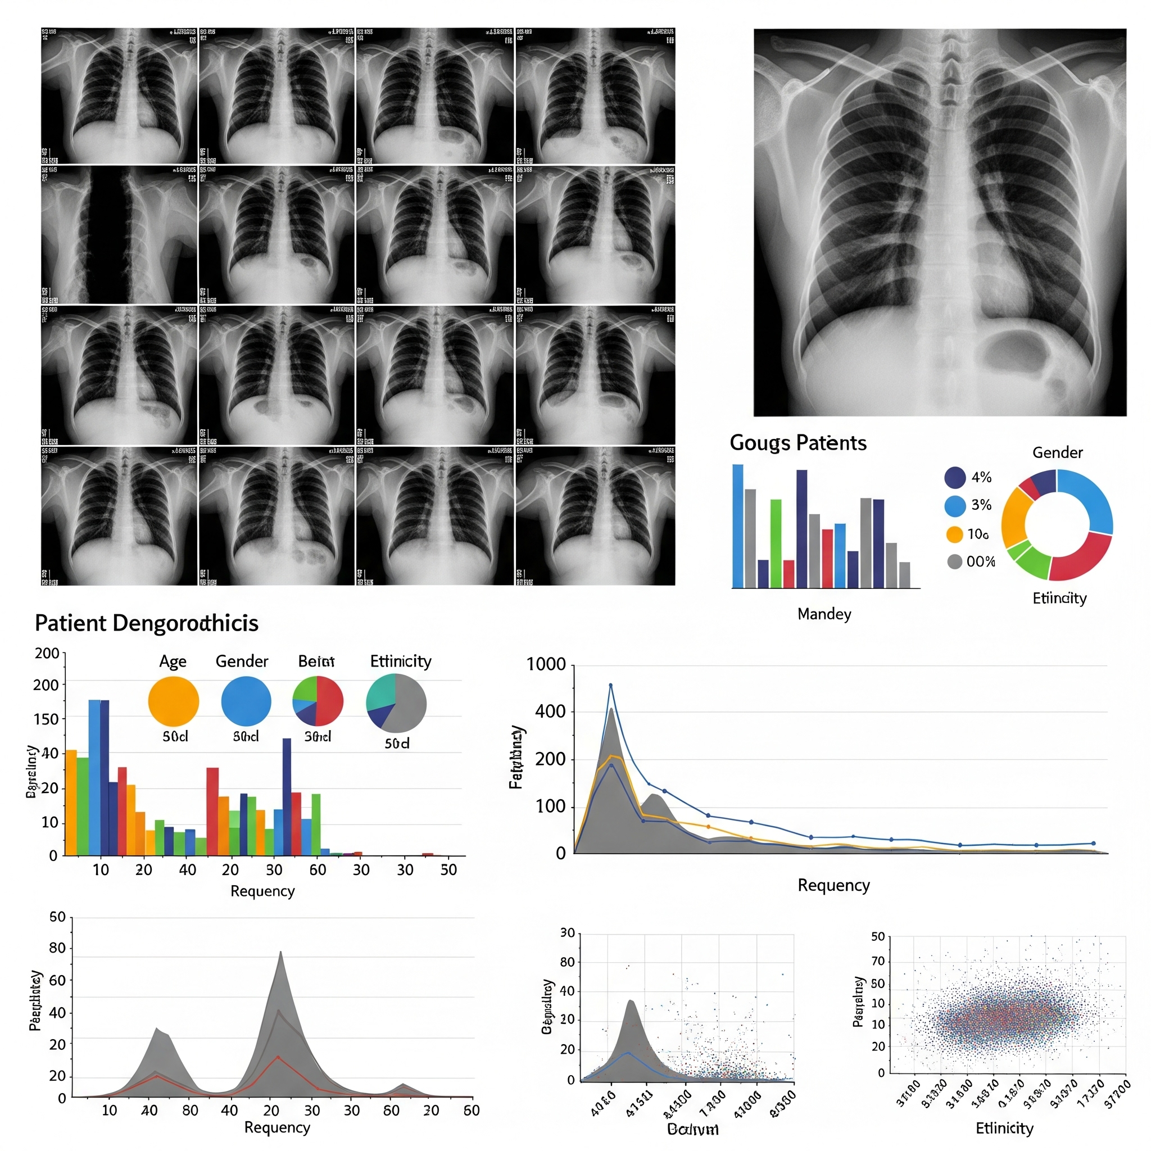
Dataset Exploration: COVID-QU
Structure
Lung & Infection Segmentation Data
Subsets: Train / Val / Test
Classes: COVID-19, Non-COVID, Normal
Severity Levels:
Mild (<10%)
Moderate (10-25%)
Severe (25-50%)
Critical (>50%)
Key Components:
Original Images
Lung Masks
Infection Masks
Understand the data distribution for training.

Slide 8
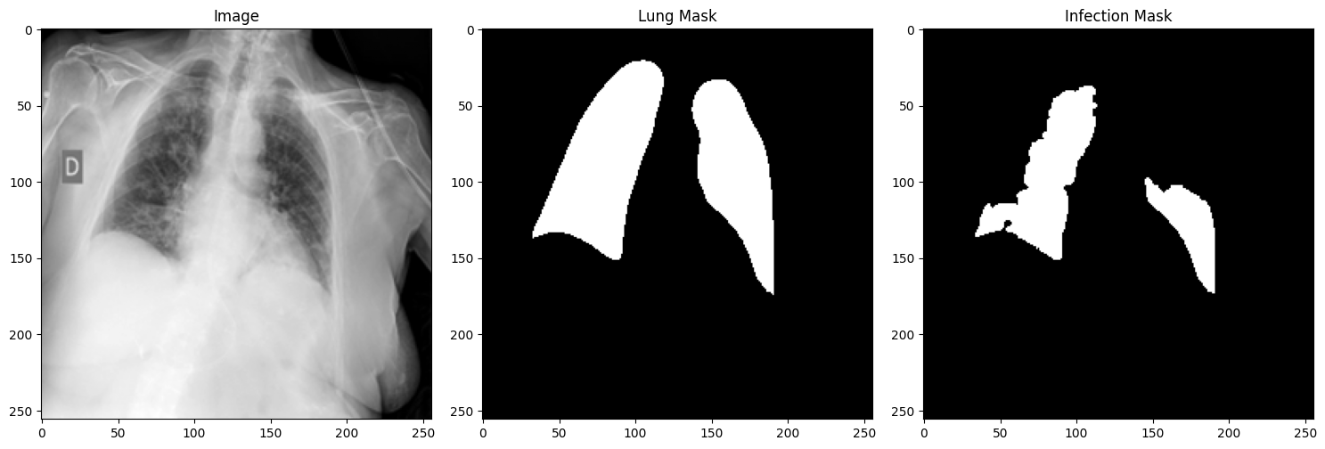
Data Image Sample
Structure
Lung & Infection Segmentation Data
Subsets: Train / Val / Test
Classes: COVID-19, Non-COVID, Normal
Severity Levels:
Mild (<10%)
Moderate (10-25%)
Severe (25-50%)
Critical (>50%)
Key Components:
Original Images
Lung Masks
Infection Masks
Understand the data distribution for training.

Slide 9
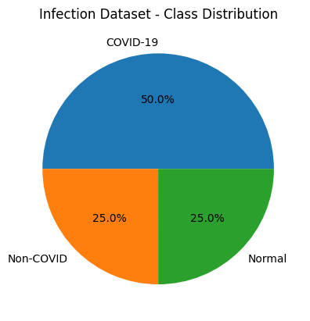
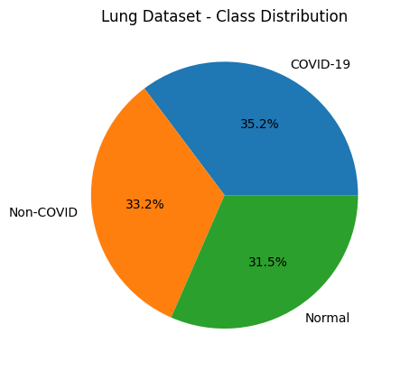
Dataset Distribution

Slide 10
Data Ethics
Public data - Kaggle
Data Privacy
Consent & Usage Rights

Slide 11
Model Training and Results

Slide 12
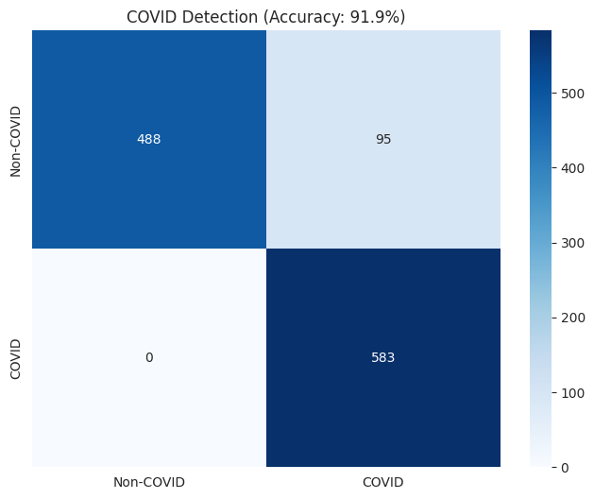
Binary Classification Prediction
COVID-19 Detection (Binary Classifier)
Dataset labeled as COVID-19 or Non-COVID
Used DenseNet121 (pretrained) + GlobalAvgPooling + Dense(1, sigmoid)
Image augmentation with rotation, shift, flip
Loss: Binary Crossentropy | Metrics: Accuracy, AUC
Test Accuracy: 91% | AUC: 99.4%

Slide 13
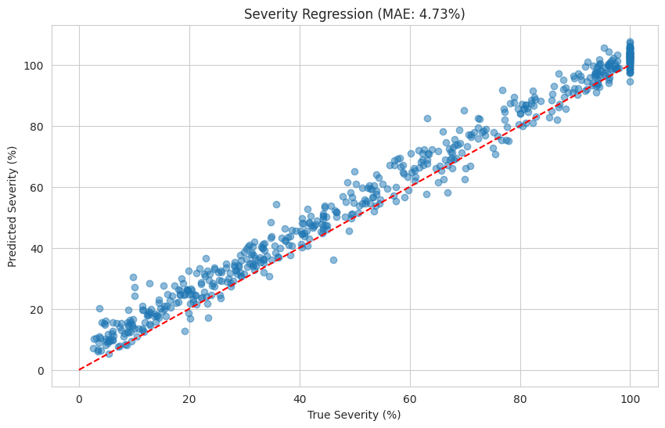
Severity Score Prediction - 1st Model
Model Architecture
Base: DenseNet121 (pretrained on ImageNet, frozen)
Top layers:
→ GlobalAveragePooling2D()
→ Dense(128, relu) + Dropout(0.5)
→ Dense(N, softmax) (N = # of severity classes)
Training
Optimizer: Adam (lr=1e-4)
Loss: Categorical Cross Entropy
Metrics: Accuracy
Callbacks: EarlyStopping + ModelCheckpoint
Trained for up to 30 epochs

Slide 14
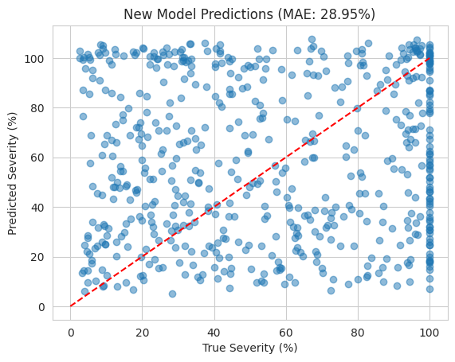
Severity Score Prediction - 2nd Model
Model Architecture
Base Model:
EfficientNetB0 (pretrained on ImageNet, include_top=False)
All layers frozen (trainable = False) during initial training to preserve learned features.
Custom Top Layers:
GlobalAveragePooling2D() – reduces spatial dimensions.
Dense(128, activation='relu') – learns higher-level representations.
Dropout(0.3) – regularizes and prevents overfitting.
Dense(1) – outputs a single continuous value for severity prediction.

Slide 15
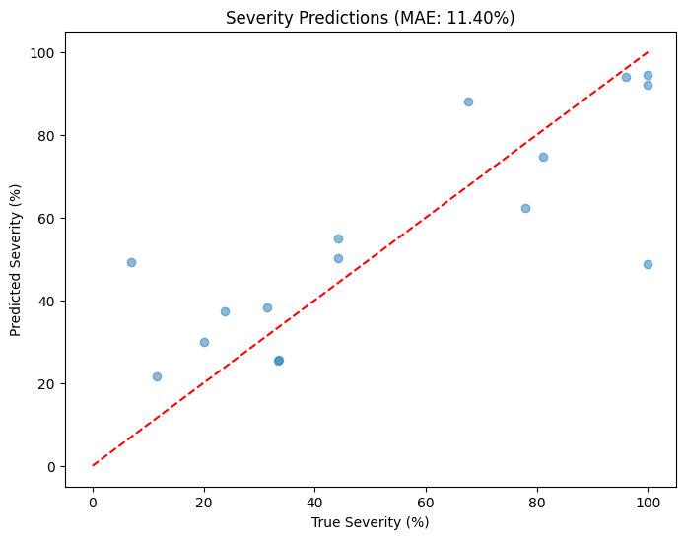
Severity Score Prediction - Custom Model
Model Architecture
Dual-Input Design:
Input 1: Chest X-ray image (RGB, 224x224) processed through a pre-trained DenseNet121 backbone.
Input 2: Infection mask (grayscale, 224x224) resized and transformed via a Conv2D layer to match feature dimensions.
Feature Fusion: Multiplies DenseNet features with mask features to focus on infected regions.
Feature Processing:
Global Average Pooling reduces spatial dimensions.
Dense layers (256 → 128 units) with Dropout (0.4) for regularization.
Final output: Single neuron predicting infection severity (%).

Slide 16
Next
steps
01.
02.
03.
04.
Improve the results and accuracy of all models
Fine-tune models and parameters
Create a website to deploy models and create to form to get feedback
Get feedback/analysis from doctors by comparing their predictions with my model

Slide 17
Any questions? Ask away!

Slide 18
Thank you
Company Name
Quarter
Month Year

